Slide 1
session title here
Add speaker names here
Track name - Date - & anything else you need to include that maybe relevant to you presentation

Slide 2
Title Slide

Slide 3
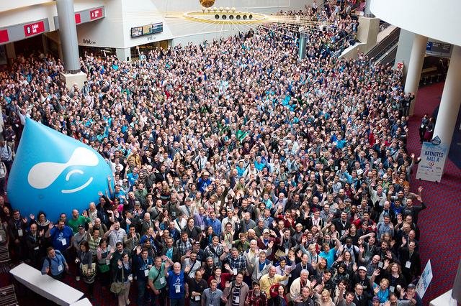
Image title slide

Slide 4
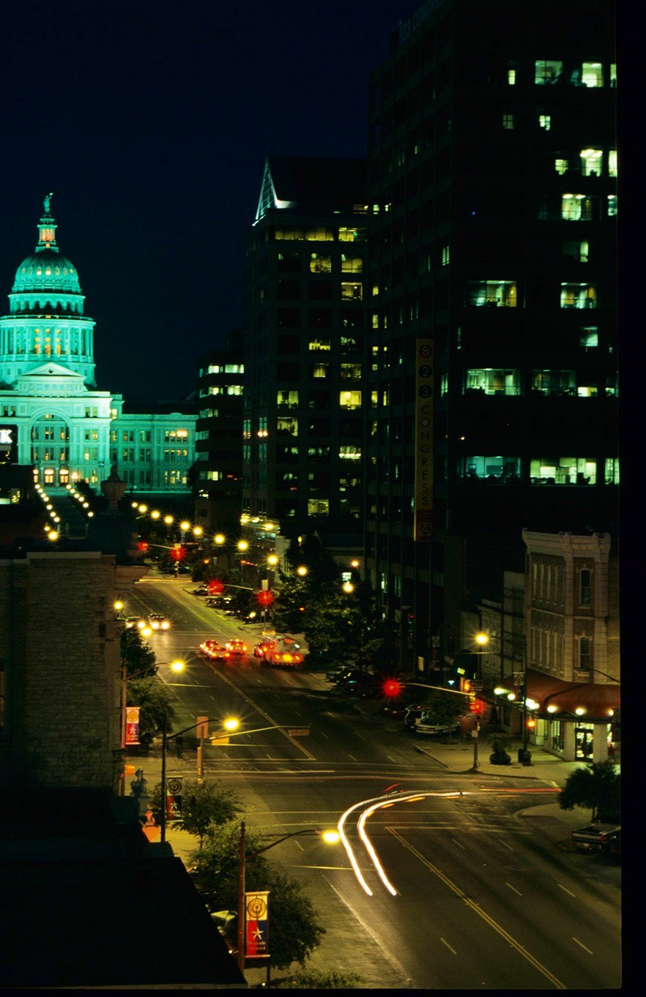
Main header title space
Carles Truffaut keffiyeh hoodie pickled, brunch +1 Austin meggings kogi. Ethical seitan twee flannel. Williamsburg crucifix authentic mustache messenger bag, umami Godard literally Blue Bottle chia. Direct trade iPhone leggings gluten-free before they sold out. Ethnic four loko shabby .

Slide 5
Top Title Space
SECOND TITLE SPACE
_{full page area for lISTS}
_{and lots of LIST SPACE}
_{As much as you want!}
_{but make sure it’s a list}

Slide 6
Top Title Space
SECOND TITLE SPACE
90's Banksy ethnic wayfarers. Selvage Carles Austin ethical. Authentic Neutra Truffaut hella. Cred viral blog hoodie, messenger bag synth craft beer next level.

Slide 7
Top Title Space
SECOND TITLE SPACE
90's Banksy ethnic wayfarers. Selvage Carles Austin ethical. Authentic Neutra Truffaut hella. Cred viral blog hoodie, messenger bag synth craft beer next level.
90's Banksy ethnic wayfarers. Selvage Carles Austin ethical. Authentic Neutra Truffaut hella. Cred viral blog hoodie, messenger bag synth craft beer next level.

Slide 8
“Yes, we have to divide up our time like that, between our politics and our equations. But to me our equations are far more important, for politics are only a matter of present concern. A mathematical equation stands forever.”
– Albert Einstein

Slide 9
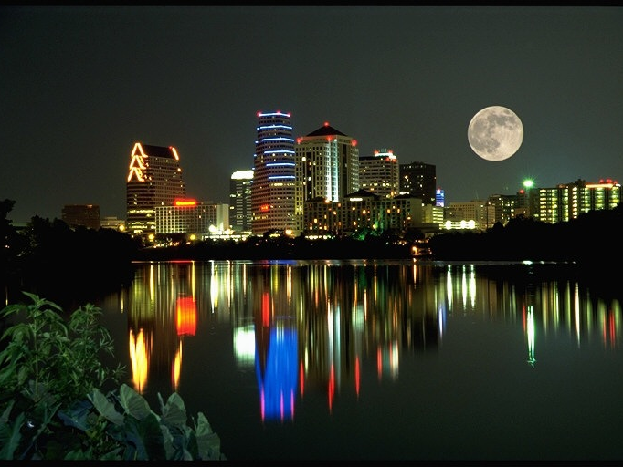

Slide 10
What did you think?
evaluate this session:
austin2014.drupal.org/schedule
Thank you!

